Slide 1

Mutual Fund
BF
Analytics
ERA OF TRADER
Capstone Project Report
Prepared by: Sahil Pratap Singh
Role: Data Analyst Intern | Bluestock Fintech Pvt. Ltd.
June 2025
CONFIDENTIAL · INTERNAL USE ONLY

Slide 2
Problem Statement & Objectives
The Problem
Objectives
No unified view of mutual fund performance across AMCs
Fragmented raw data: NAV, AUM, SIP, investor transactions in silos
No standardised scoring model to compare risk-adjusted returns
Lack of investor demographic & geographic analytics
Manual, Excel-based analysis: error-prone & unscalable
01
Build end-to-end ETL pipeline for 8 data sources into a normalized SQLite DB
02
Perform EDA: AUM trends, NAV distributions, SIP growth patterns
03
Compute composite performance scores (CAGR, Sharpe, Alpha, Max DD)
04
Analyse investor demographics: geography, age, transaction type
05
Deliver 5-page interactive Power BI dashboard suite
2 / 12

Slide 3
Data Sources & Coverage
8 heterogeneous datasets · ~48,000 records · Jan 2022 – Mar 2025
Scheme Master
NAV History
AUM Data
SIP Inflow
40 schemes, 8 fund houses
~12,000 daily NAV rows
160 rows — monthly
~800 rows — by category
Folio Count
Investor Txns
Market Index
Performance
160 rows — by AMC & period
33,000 simulated records
~1,800 NIFTY 50/100 rows
40 rows — computed metrics
3 / 12

Slide 4
ETL Architecture & Pipeline
01
02
03
04
05
06
Extract
Clean
Transform
Load
Analyse
Visualise
8 CSV sources
AMFI · NSE · Simulated
›
347 dupes removed
12 NAV imputed, outliers
›
Feature engineering
Rolling avg · Derived cols
›
SQLite DB (8 tables)
Star schema design
›
EDA + Perf Scoring
Composite 0-100 Score
›
Power BI Dashboards
5 interactive pages
SQLite Database · 8 tables · ~48K rows | Star Schema · FK constraints · Composite indexes on (scheme_code, date)
4 / 12

Slide 5
EDA Highlights — Industry & AUM Analysis
39M
133%
258%
51%
Total Industry AUM
(Crore)
AUM Growth
2022 → 2024
Folio Growth
2022 → 2025
Top 3 AMC AUM
Concentration
5 / 12

Slide 6
EDA Highlights — SIP Growth & Investor Analytics
33K
4bn
5K
53%
Total Transactions
Total Investment (INR)
Unique Investors
SIP Accounts YoY
6 / 12

Slide 7
Fund Performance Metrics
Composite Score = 40% CAGR + 30% Sharpe + 20% Alpha + 10% (1 – |MaxDD|) → Normalised 0-100
94.41
0.54
16%
−0.53
Highest Fund Score
(Mirae Asset LC)
Avg Sharpe Ratio
All Funds
Avg 3Y CAGR
Equity Funds
Worst Max Drawdown
Industry
Rank | Fund Name | Category | CAGR 3Y | Sharpe | Alpha | Score
1 | Mirae Asset Large Cap — Reg | Equity | 0.32 | 1.21 | 0.24 | 94.41
2 | ICICI Pru Midcap — Reg | Equity | 0.28 | 0.98 | 0.19 | 89.00
3 | ABSL Frontline Equity — Reg | Equity | 0.29 | 1.03 | 0.21 | 80.01
4 | SBI Bluechip — Regular | Equity | 0.25 | 0.87 | 0.18 | 74.00
5 | HDFC Midcap Opps — Regular | Equity | 0.31 | 0.91 | 0.22 | 71.00
7 / 12

Slide 8
Risk-Return & Alpha Analysis
Key Insights
Equity funds: CAGR 0.20–0.35, Sharpe 0.80–1.21 — strong risk-adjusted returns
Debt funds: near-zero Sharpe & CAGR — ideal for capital preservation
Mirae Asset Large Cap: best Sharpe (1.21) among equity funds
DSP Small Cap: highest Alpha (0.28) with higher drawdown (-0.35)
Avg Alpha (equity) = 0.19 — consistent outperformance vs NIFTY 50
ABSL Small Cap: negative CAGR (-0.05) — lowest composite score 27.46
8 / 12

Slide 9
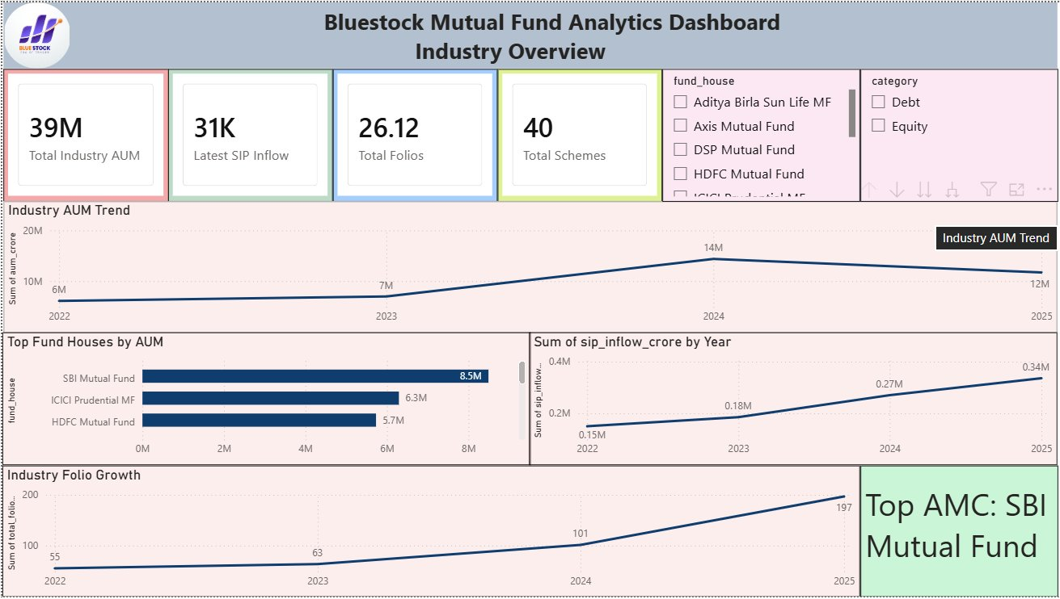
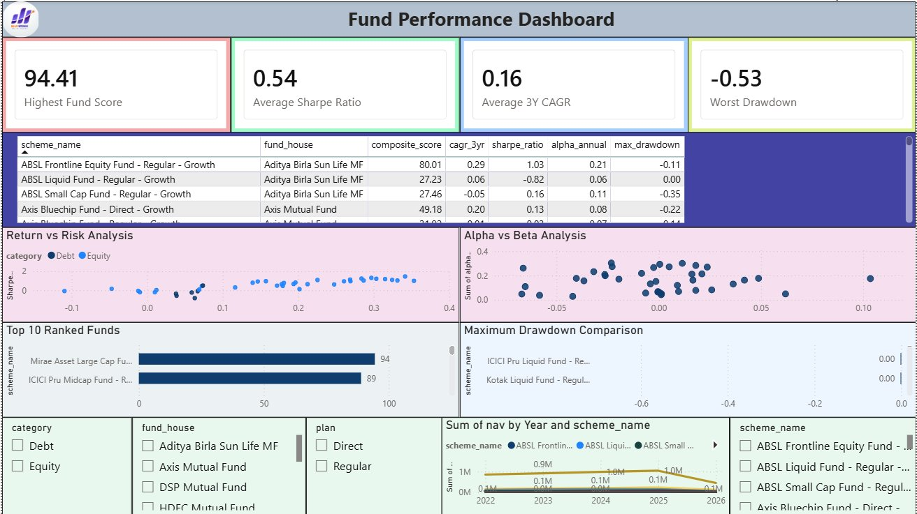
Power BI Dashboards — Industry Overview & Fund Performance
Dashboard 1 | Industry Overview
Dashboard 2 | Fund Performance
9 / 12

Slide 10
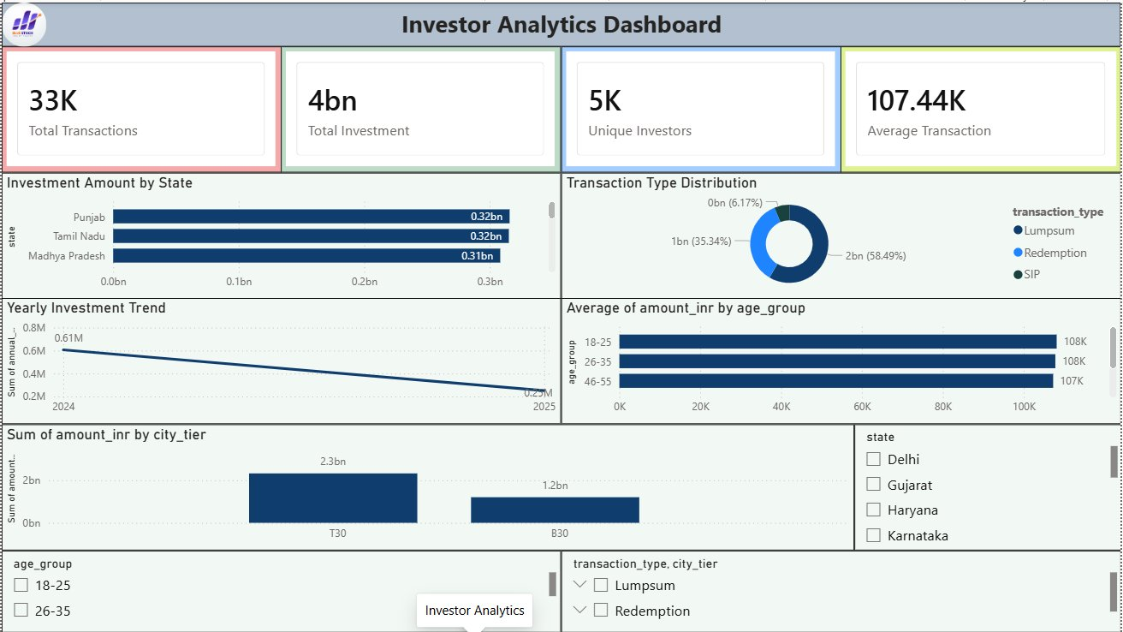
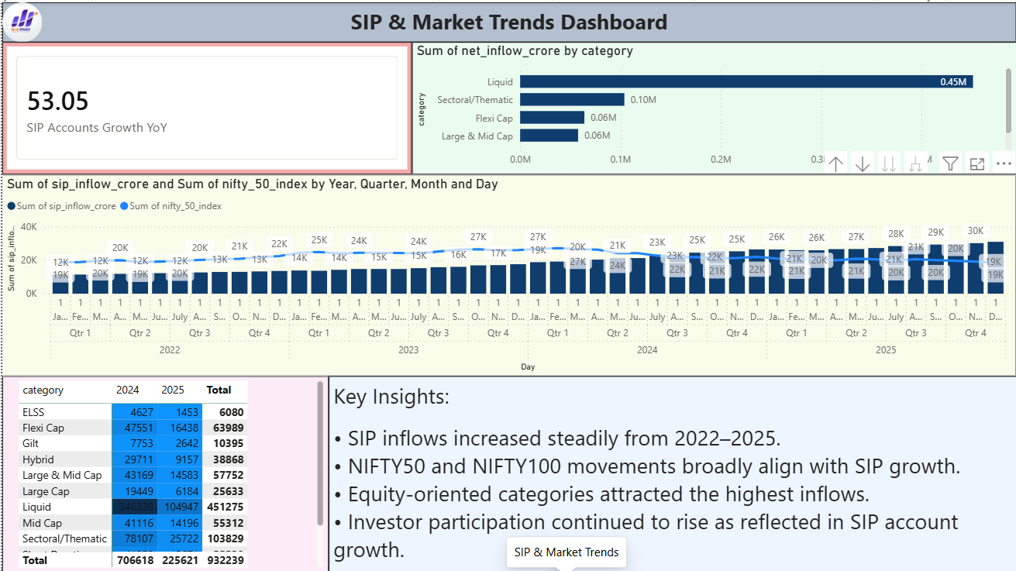
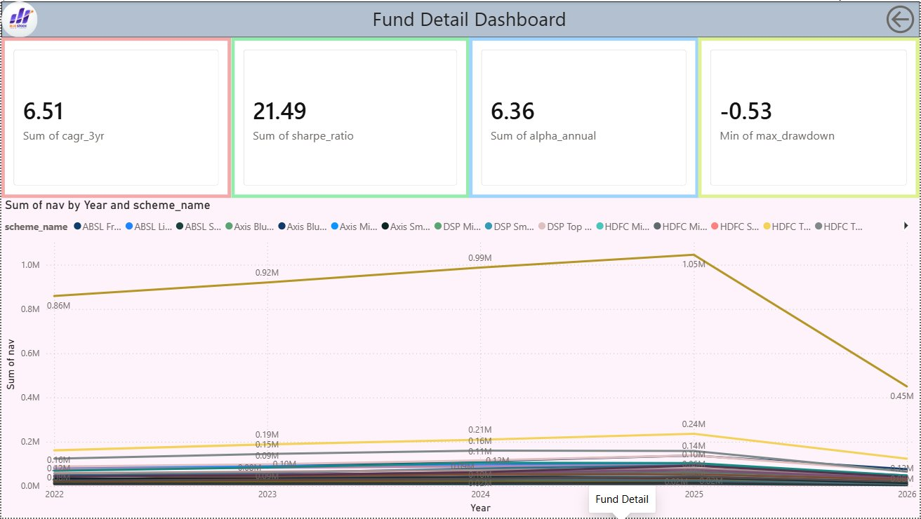
Power BI Dashboards — Investor Analytics, SIP Trends & Fund Detail
Dashboard 3 | Investor Analytics
Dashboard 4 | SIP & Market Trends
Dashboard 5 | Fund Detail
Key Dashboard Features: Cross-filter by Fund House · Category · Plan · State · Age Group · Transaction Type | Drill-through from Industry → Fund Detail | Live KPI cards · Scatter plots · Bar/Line charts · Donut · Tables
10 / 12

Slide 11
Key Findings & Recommendations
1
AUM Leadership
2
SIP Surge
3
Top Performer
SBI MF dominates with 8.5M crore. Top 3 AMCs hold 51% of industry AUM, posing concentration risk.
SIP inflows grew 127% (2022–2025). SIP accounts grew 53% YoY — strongest retail adoption metric.
Mirae Asset Large Cap leads with score 94.41 & Sharpe 1.21 — best risk-adjusted equity fund.
4
B30 Opportunity
5
Folio Explosion
6
ELSS Decline
B30 cities contribute 34.3% (1.2bn INR) of transactions — significant untapped rural growth potential.
Folio count surged 258% (55L → 197L folios), indicating mass democratisation of MF investing.
ELSS inflows fell 69% in 2025 post new tax regime. AMCs need product innovation to restore demand.
11 / 12

Slide 12
Thank You!
Bluestock Fintech — Mutual Fund Analytics Capstone
Prepared by: Sahil Pratap Singh | Data Analyst Intern | Bluestock Fintech Pvt. Ltd.
June 2025 · Confidential — Internal Use Only
ERA OF TRADER

